Slide 1
NO MAN IS AN ISLAND,
ENTIRE OF ITSELF,
EVERY MAN IS A PIECE OF THE CONTINENT,
A PART OF THE MAIN.
IF A CLOD BE WASHED AWAY BY THE SEA,
EUROPE IS THE LESS.
AS WELL AS IF A PROMONTORY WERE.
AS WELL AS IF A MANOR OF THY FRIEND'S
OR OF THINE OWN WERE:
ANY MAN'S DEATH DIMINISHES ME,
BECAUSE I AM INVOLVED IN MANKIND,
AND THEREFORE NEVER SEND TO KNOW FOR WHOM THE BELL TOLLS;
IT TOLLS FOR THEE.
JOHN DONNE
(1624)

Slide 2
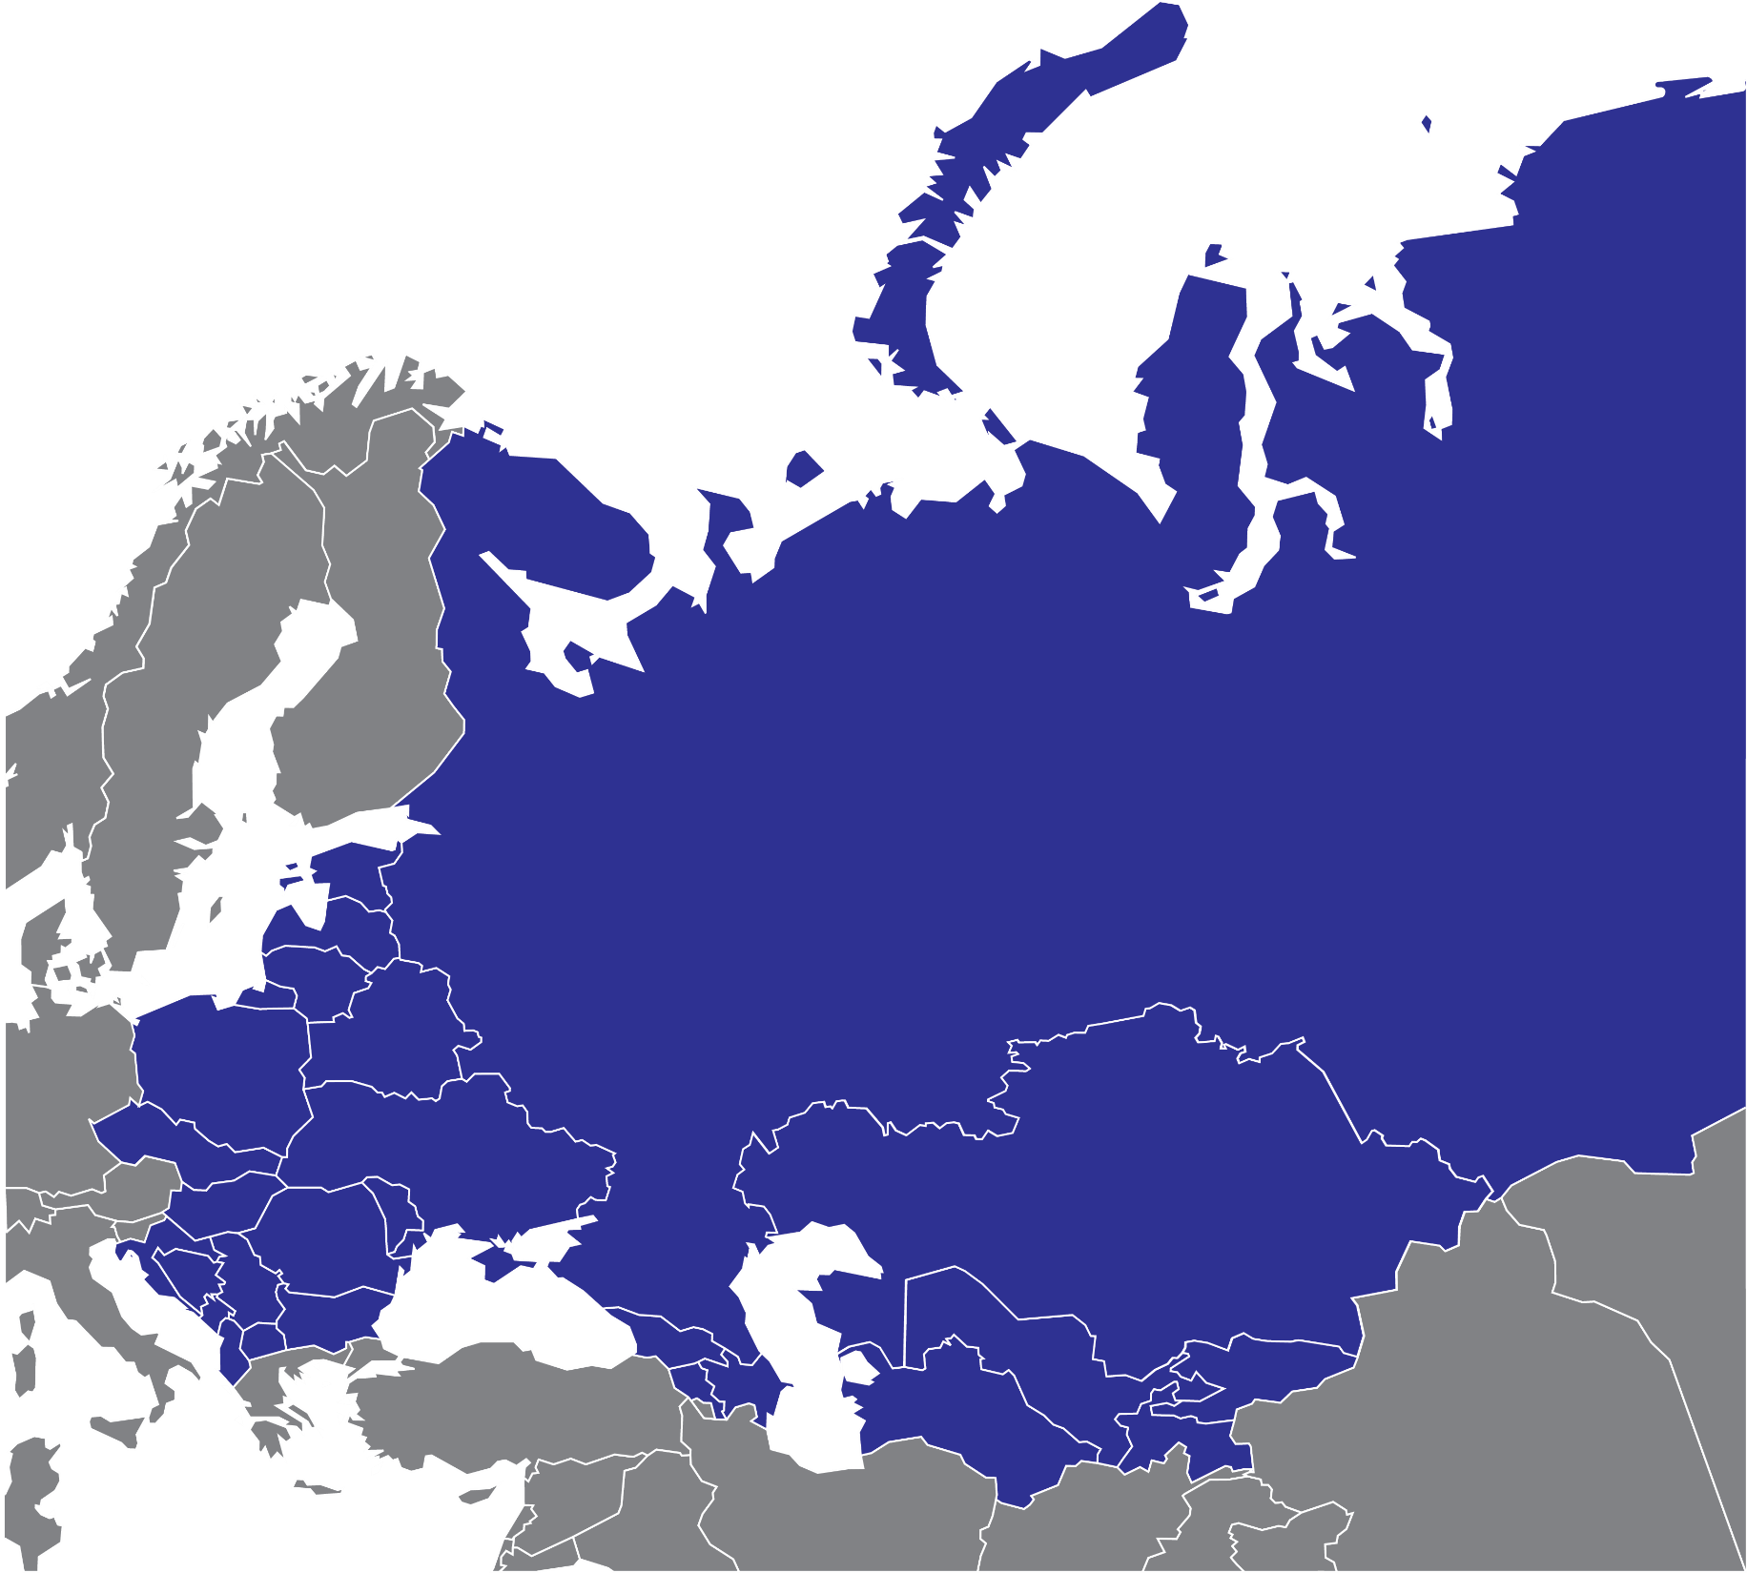
EECA COUNTRIES
IS NOT EU
BUT PART OF
EUROPEAN REGION

Slide 3
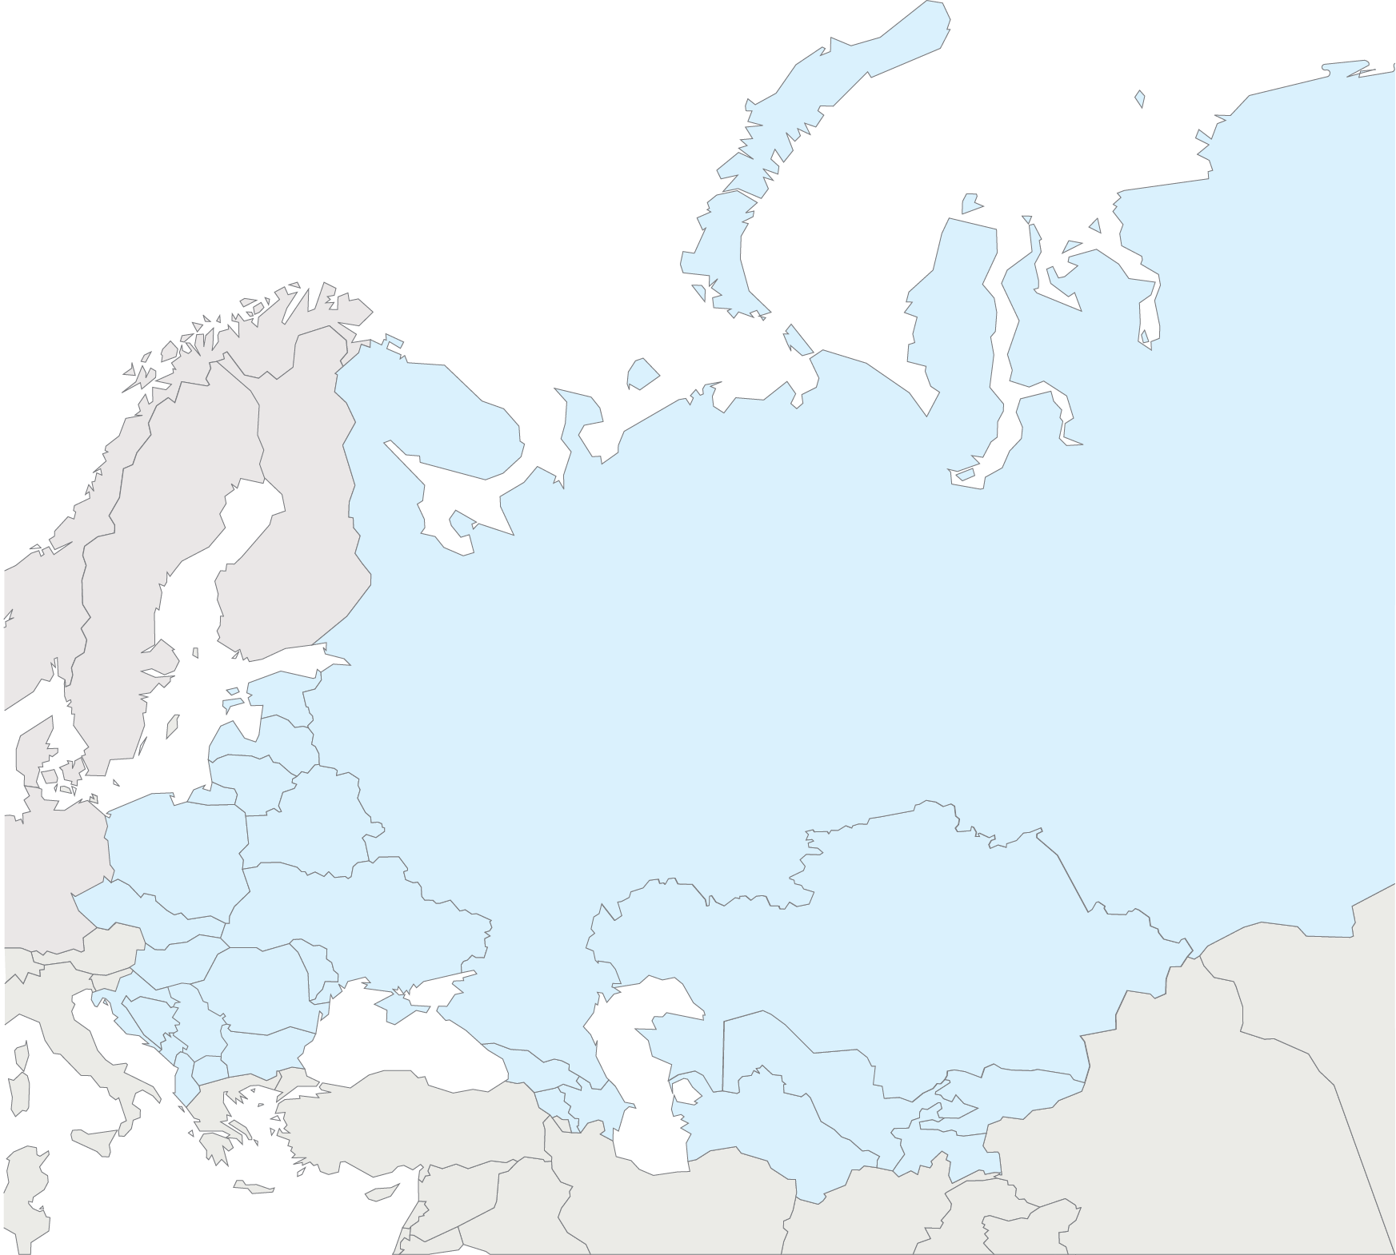
Treatment coverage is just 28% [22–32%] among people living with HIV in Eastern Europe and Central Asia.
New HIV infections rose by 60%
between 2010 and 2016.
In 2016, there were 1.6 million [1.4 million–1.7 million] people living with HIV in Eastern Europe and Central Asia.
In Еastern Europe and Сentral Asia, 40 000
[32 000–49 000] people died of AIDS-related illnesses in 2016.
In 2016, there were an estimated 190 000 [160 000–220 000] new HIV infections
in the region.

Slide 4
In 2016, there were an estimated 190 000 [160 000–220 000] new HIV infections
in the region.

Slide 5
New HIV infections rose by 60%
between 2010 and 2016.

Slide 6
In Еastern Europe and Сentral Asia, 40 000
[32 000–49 000] people died of AIDS-related illnesses in 2016.

Slide 7
Between 2010 and 2016, the number
of AIDS-related deaths in the region
increased by 27%.

Slide 8
Treatment coverage is just 28% [22–32%] among people living with HIV in Eastern Europe and Central Asia.

Slide 9
In 2016, there were 1.6 million [1.4 million–1.7 million] people living with HIV in Eastern Europe and Central Asia.
In 2016, there were an estimated 190 000 [160 000–220 000] new HIV infections in the region.
New HIV infections rose by 60% between 2010 and 2016.
In Еastern Europe and Сentral Asia, 40 000 [32 000–49 000] people died of AIDS-related illnesses in 2016.
Between 2010 and 2016, the number of AIDS-
related deaths in the region increased by 27%.
Treatment coverage is just 28% [22–32%] among people living with HIV in Eastern Europe and Central Asia.

Slide 10
ECUO team presented
Regional Action Plan
of Communities on Scale Up of Access to High Quality and Continuous HIV Care for all who needs it in the Region of EECA in 2017-2020

Slide 11
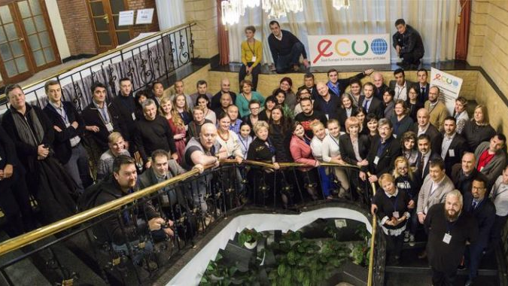
ECUO REGIONAL PARTNERS

Slide 12
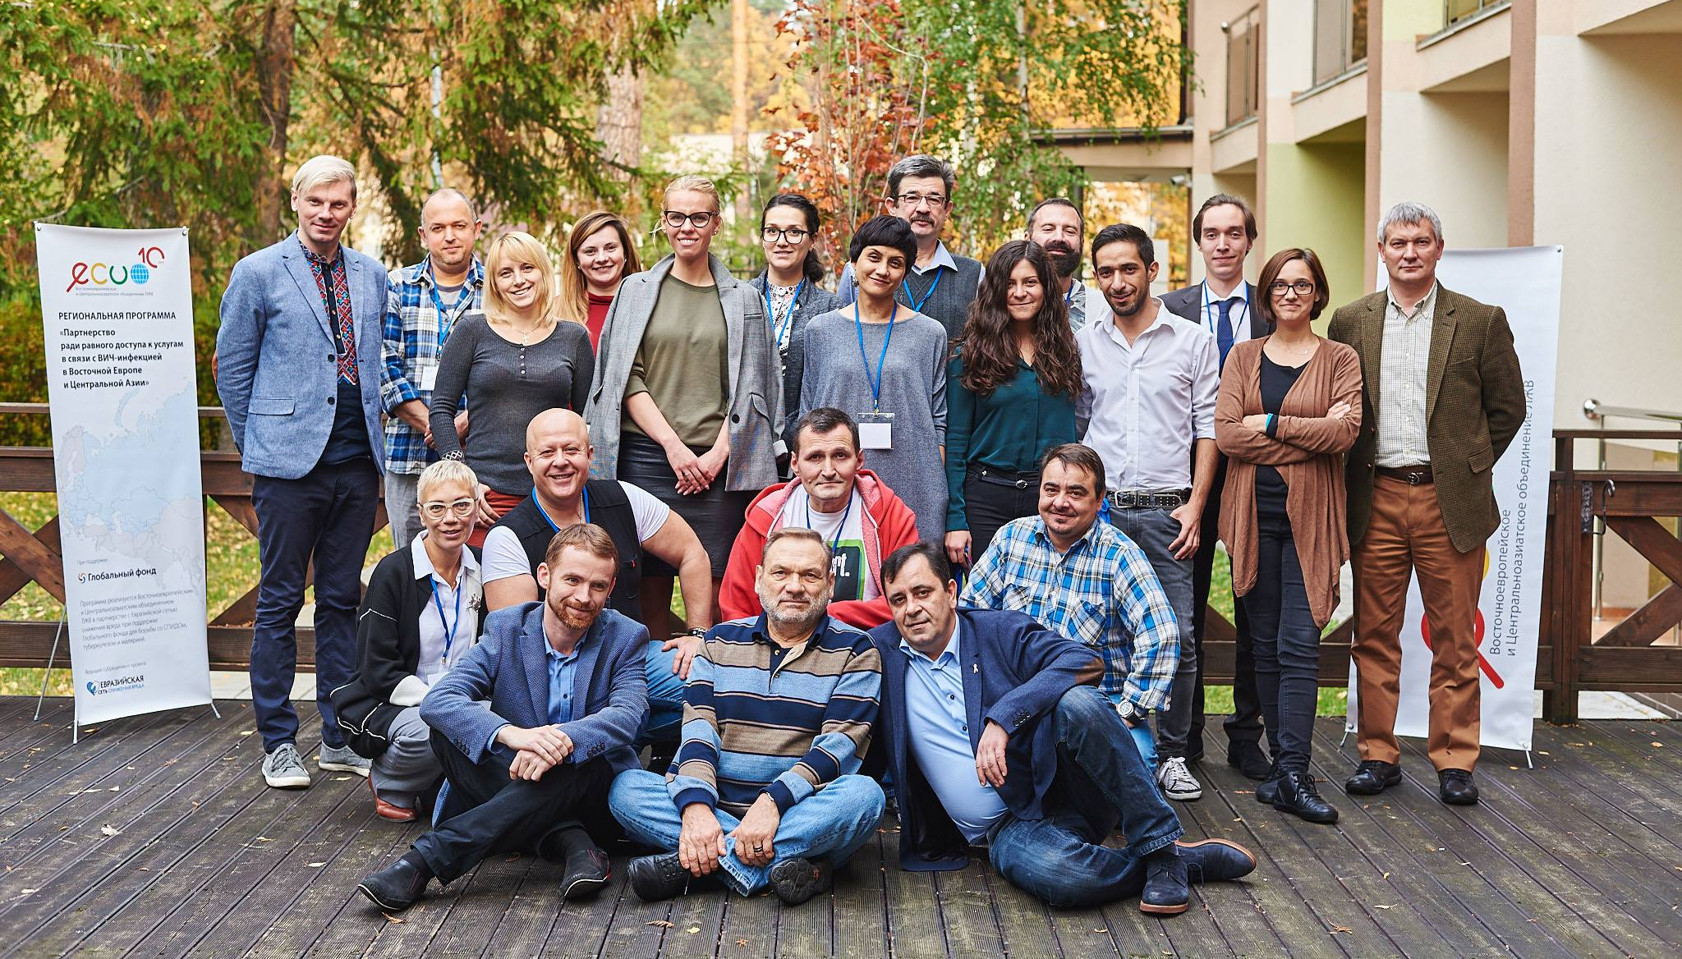
ECUO REGIONAL PARTNERS

Slide 14
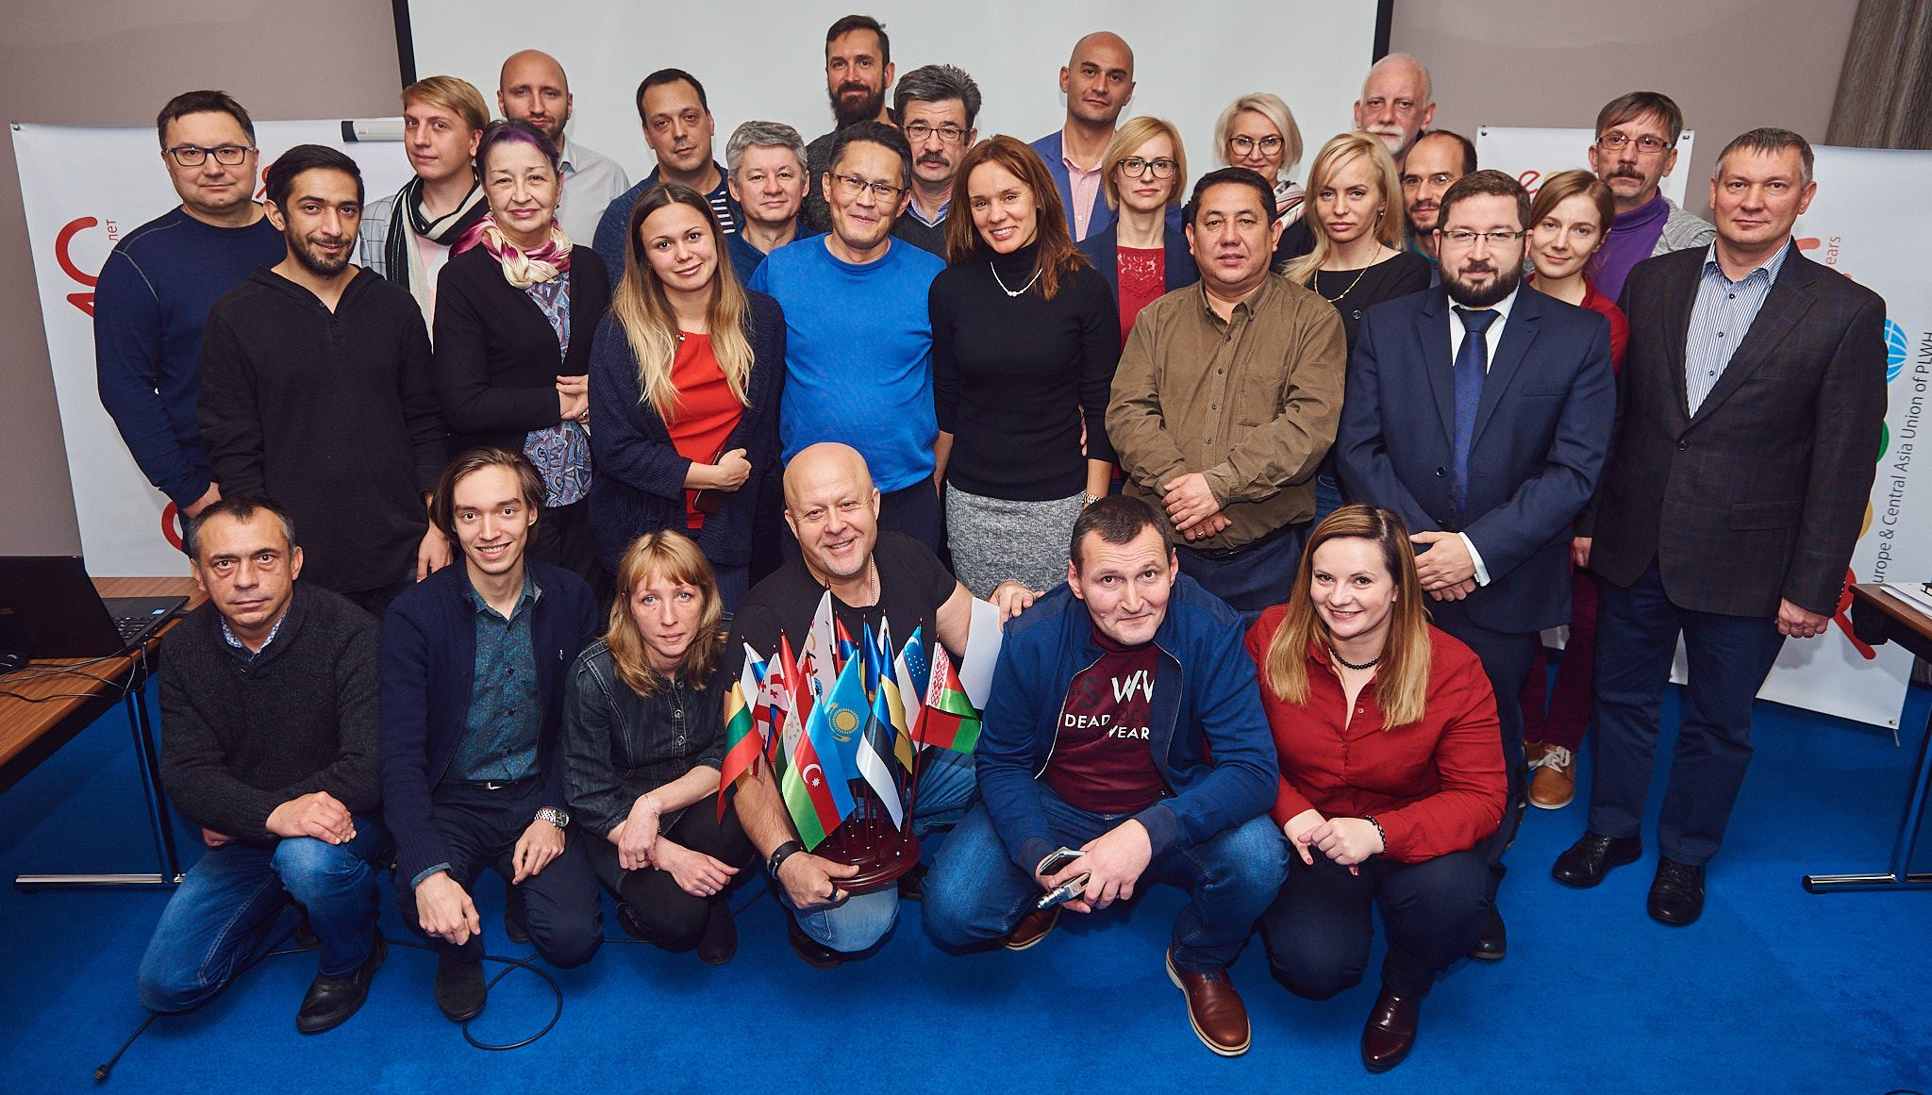

Slide 16
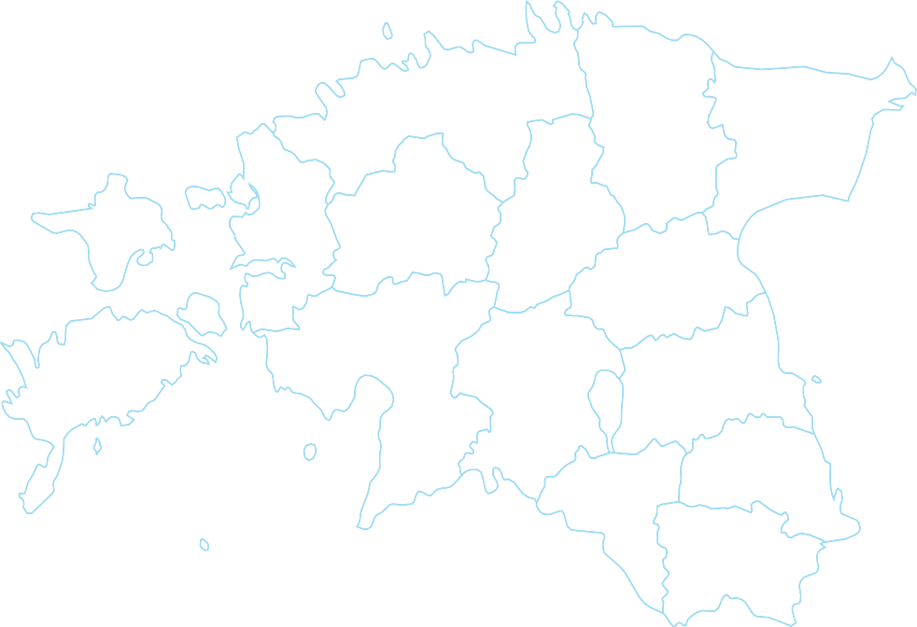
The Estonian Presidency
of the Council of the European Union

Slide 25
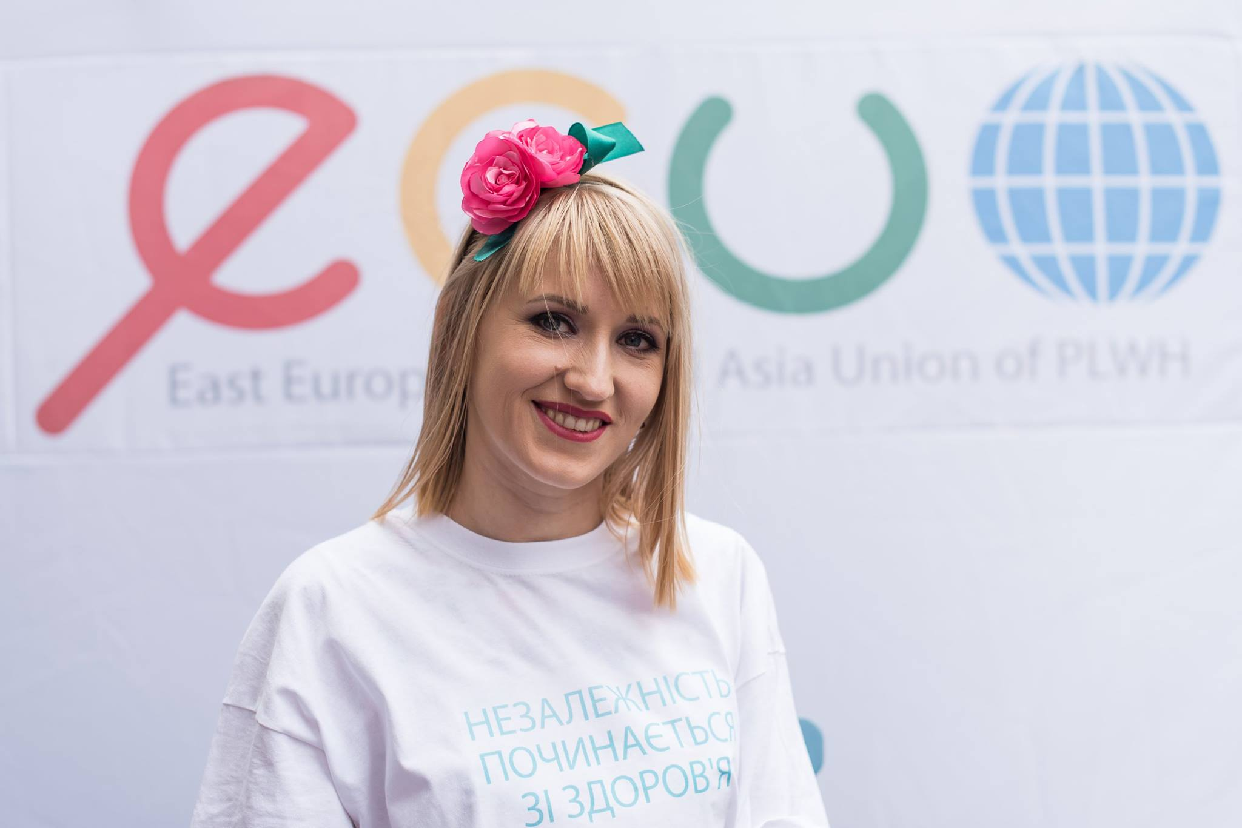

Slide 26
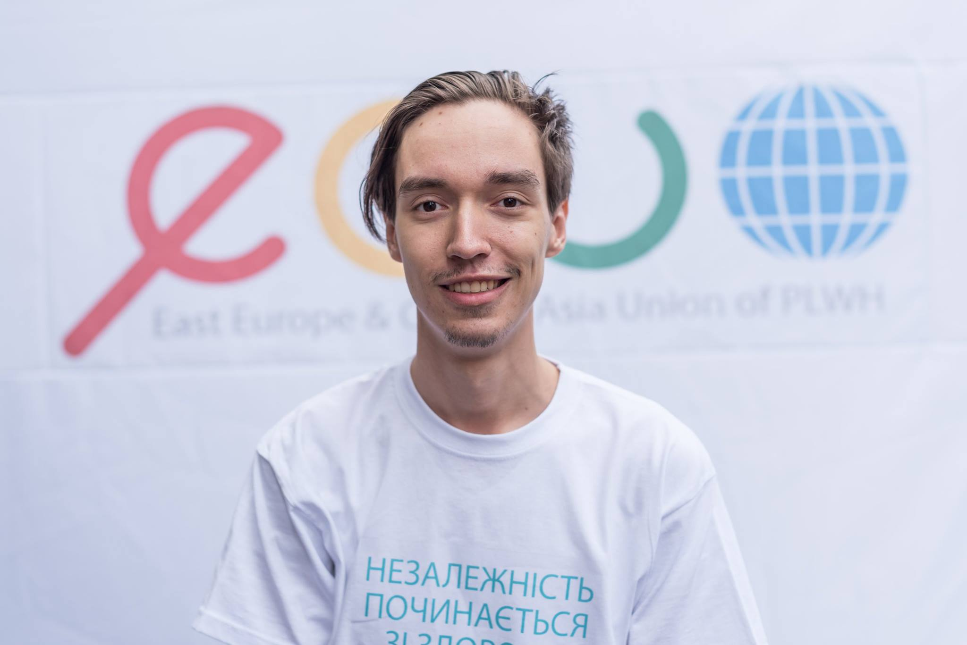

Slide 27
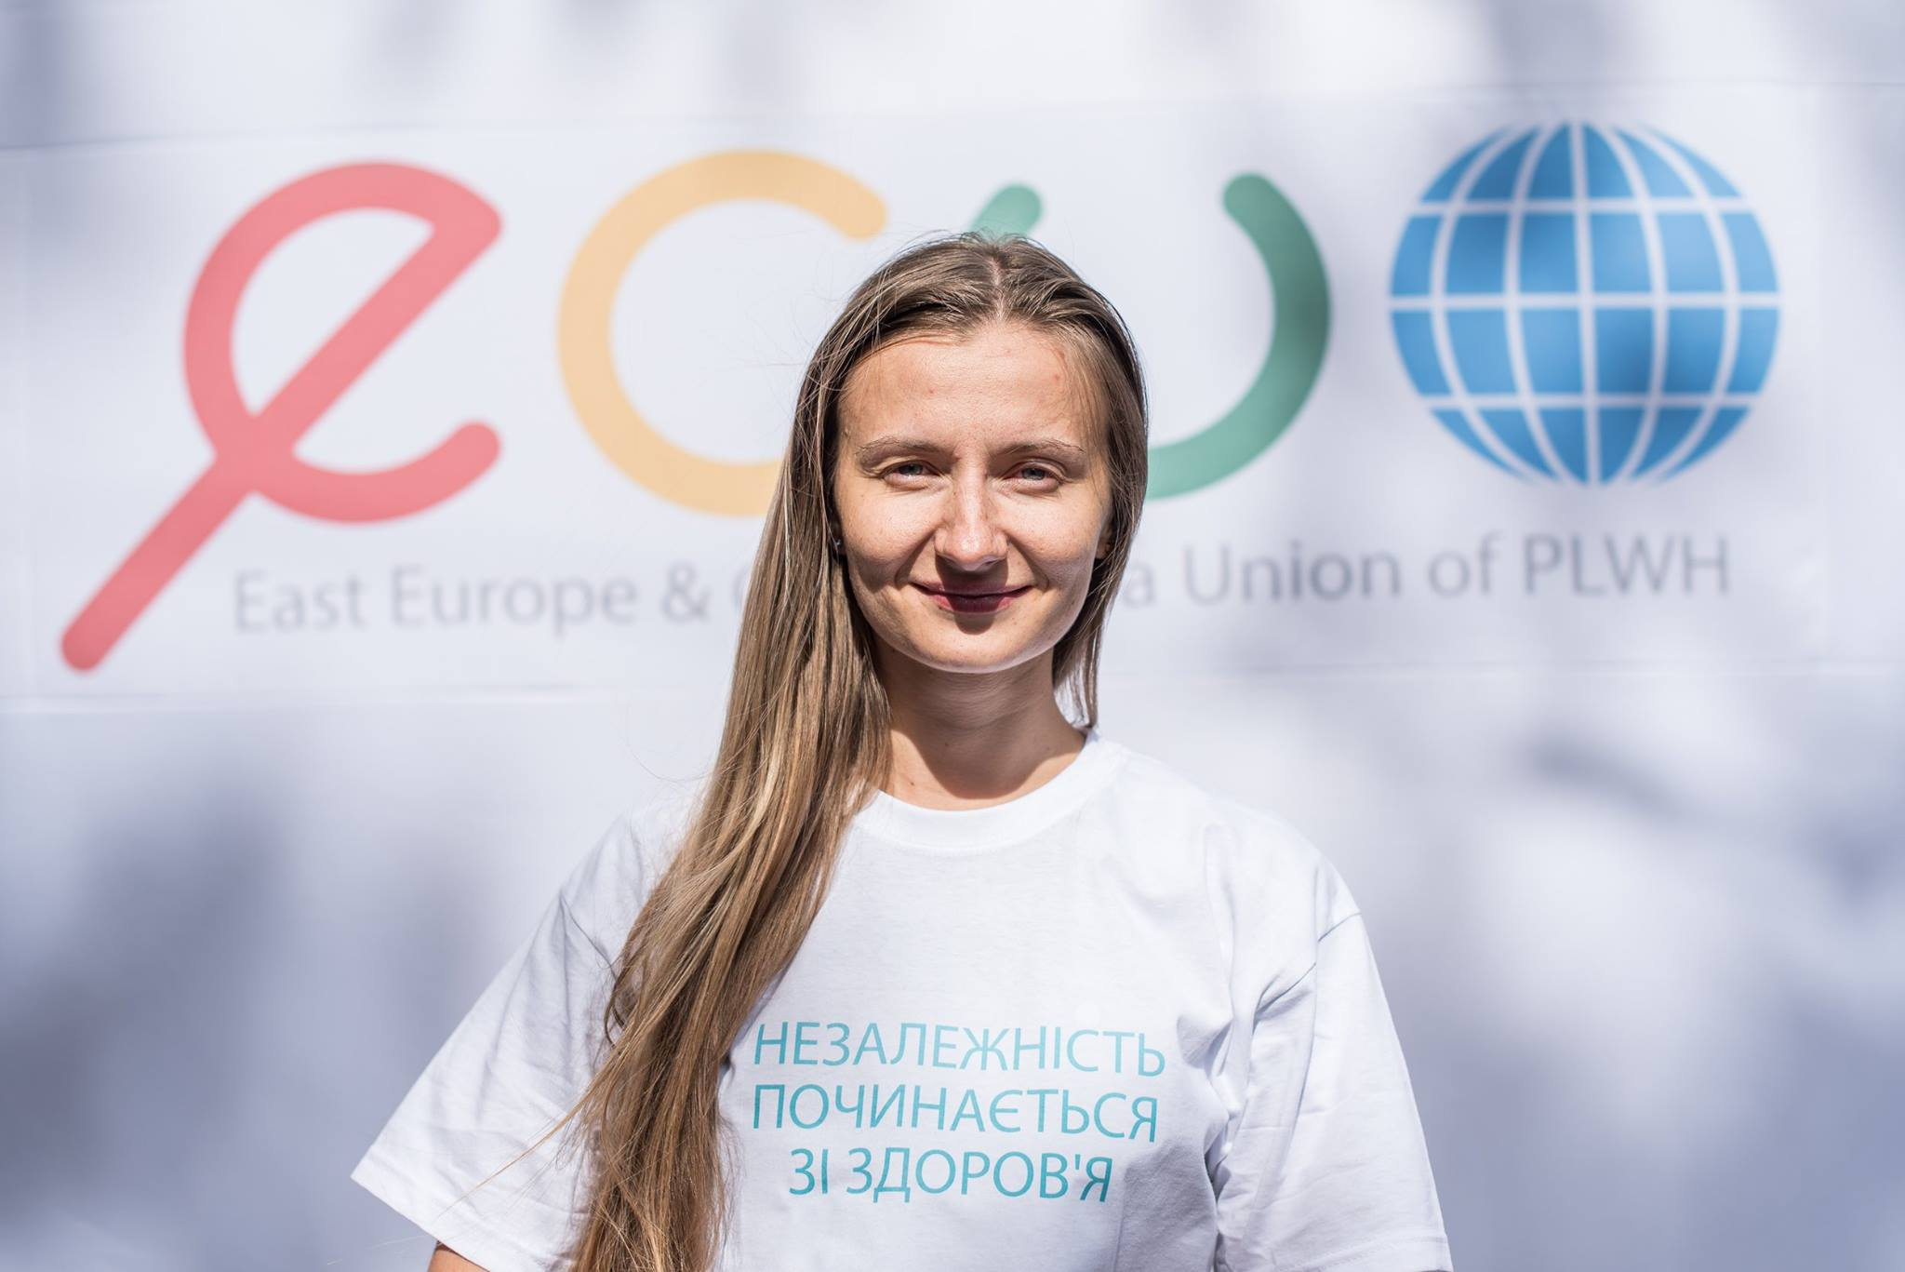

Slide 28
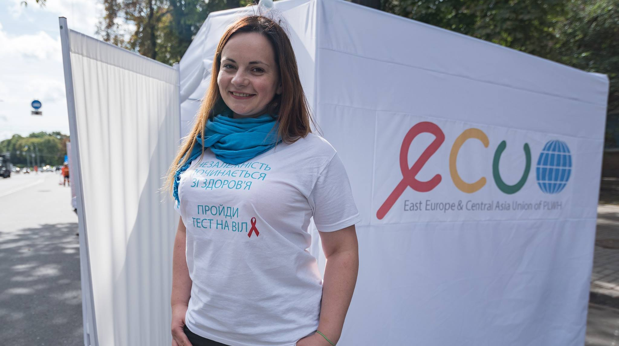

Slide 29
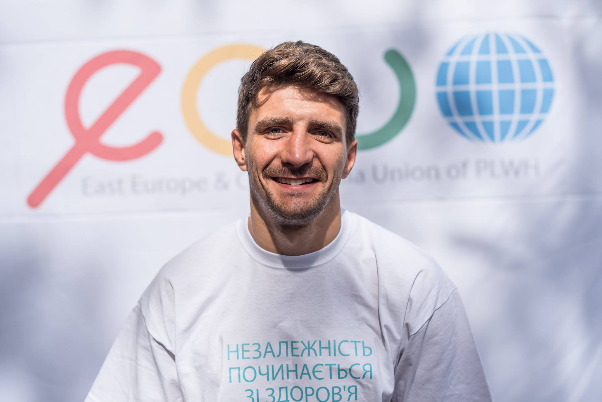

Slide 30
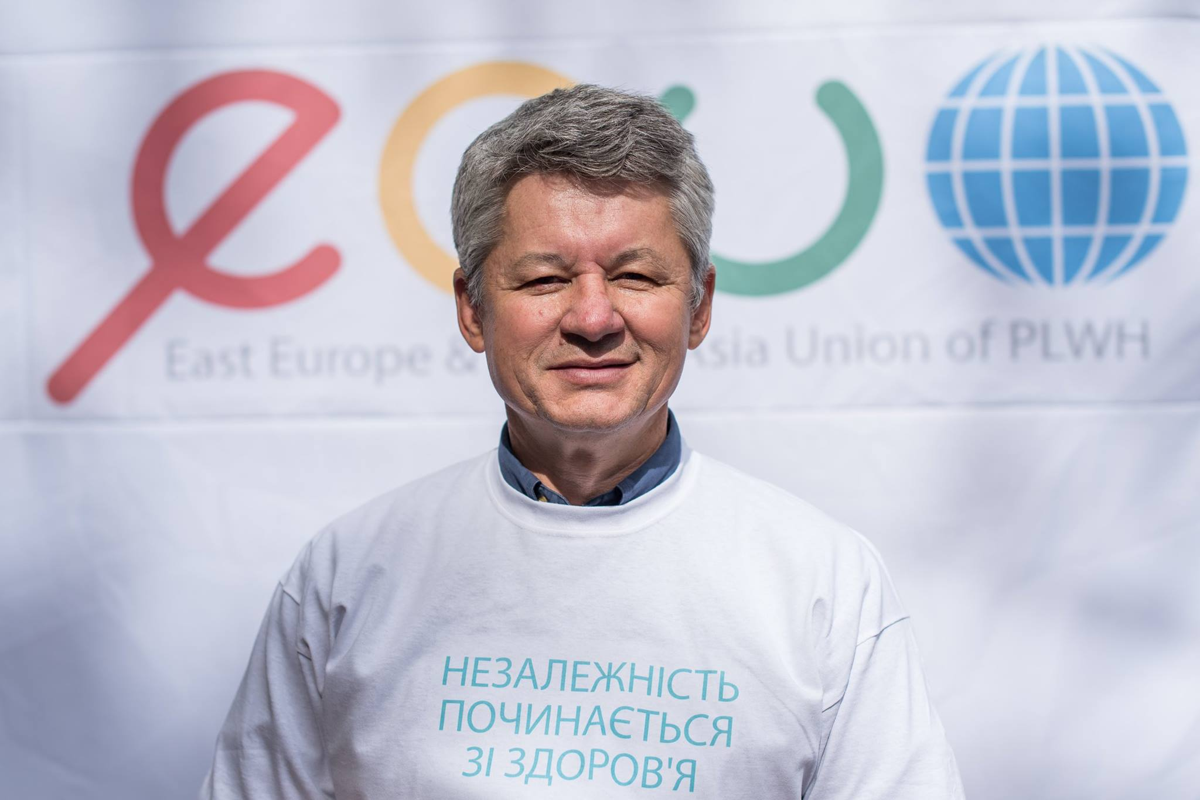

Slide 31
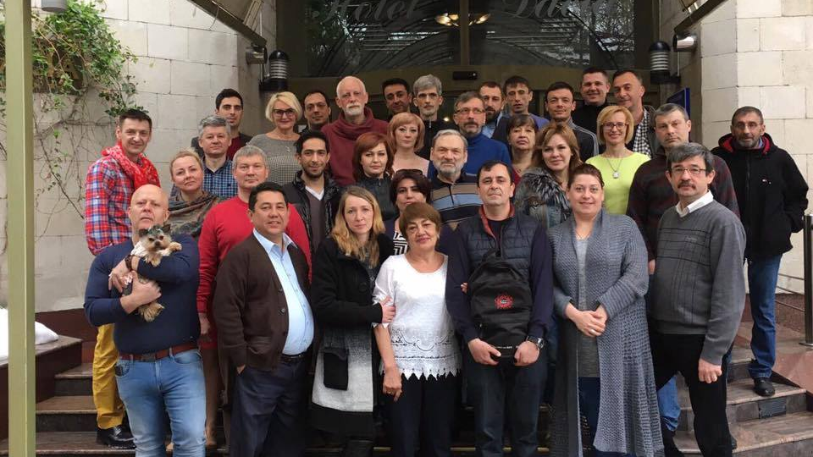
ECUO TEAM

Slide 32
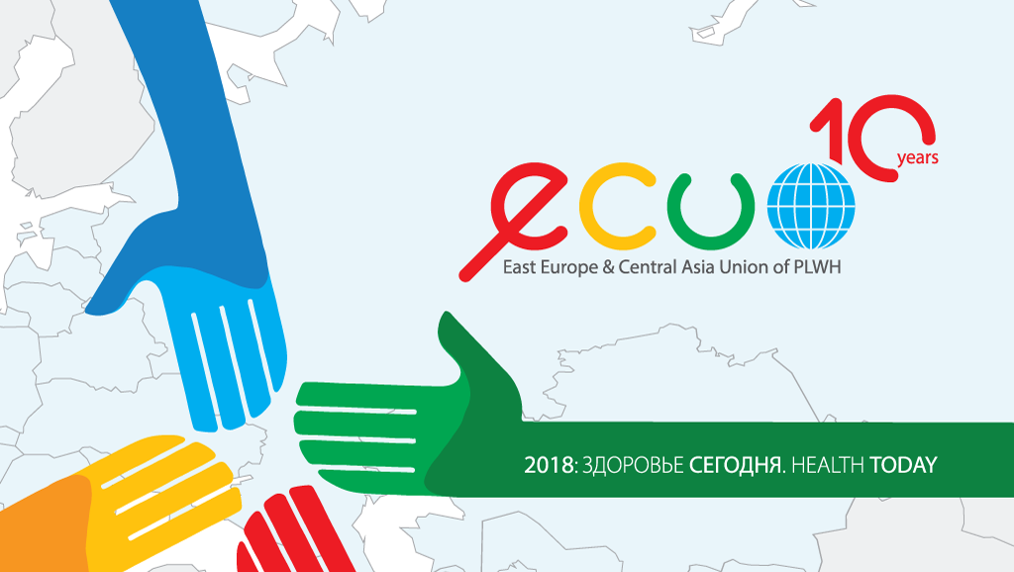

Slide 33
EECA COUNTRIES
IS NOT EU
BUT PART OF
EUROPEAN REGION

Slide 34
Treatment coverage is just 28% [22–32%] among people living with HIV in Eastern Europe and Central Asia.
New HIV infections rose by 60%
between 2010 and 2016.
In 2016, there were 1.6 million [1.4 million–1.7 million] people living with HIV in Eastern Europe and Central Asia.
In Еastern Europe and Сentral Asia, 40 000
[32 000–49 000] people died of AIDS-related illnesses in 2016.
In 2016, there were an estimated 190 000 [160 000–220 000] new HIV infections
in the region.

Slide 35
In 2016, there were an estimated 190 000 [160 000–220 000] new HIV infections
in the region.

Slide 36
New HIV infections rose by 60%
between 2010 and 2016.

Slide 37
In Еastern Europe and Сentral Asia, 40 000
[32 000–49 000] people died of AIDS-related illnesses in 2016.

Slide 38
Between 2010 and 2016, the number
of AIDS-related deaths in the region
increased by 27%.

Slide 39
Treatment coverage is just 28% [22–32%] among people living with HIV in Eastern Europe and Central Asia.

Slide 40
In 2016, there were 1.6 million [1.4 million–1.7 million] people living with HIV in Eastern Europe and Central Asia.
In 2016, there were an estimated 190 000 [160 000–220 000] new HIV infections in the region.
New HIV infections rose by 60% between 2010 and 2016.
In Еastern Europe and Сentral Asia, 40 000 [32 000–49 000] people died of AIDS-related illnesses in 2016.
Between 2010 and 2016, the number of AIDS-
related deaths in the region increased by 27%.
Treatment coverage is just 28% [22–32%] among people living with HIV in Eastern Europe and Central Asia.

Slide 41
ECUO team presented
Regional Action Plan
of Communities on Scale Up of Access to High Quality and Continuous HIV Care for all who needs it in the Region of EECA in 2017-2020

Slide 42
ECUO REGIONAL PARTNERS

Slide 43
ECUO REGIONAL PARTNERS

Slide 47
The Estonian Presidency
of the Council of the European Union

Slide 62
ECUO TEAM

